Slide 1
XOR GATE

Slide 2
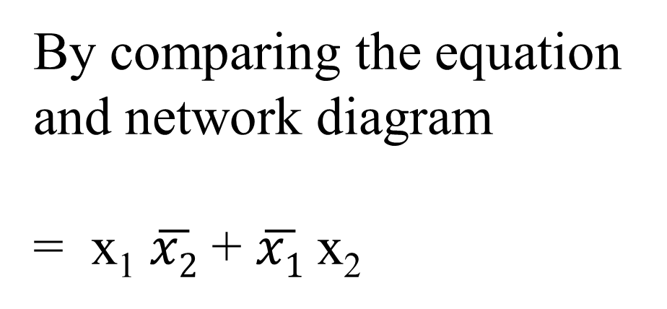
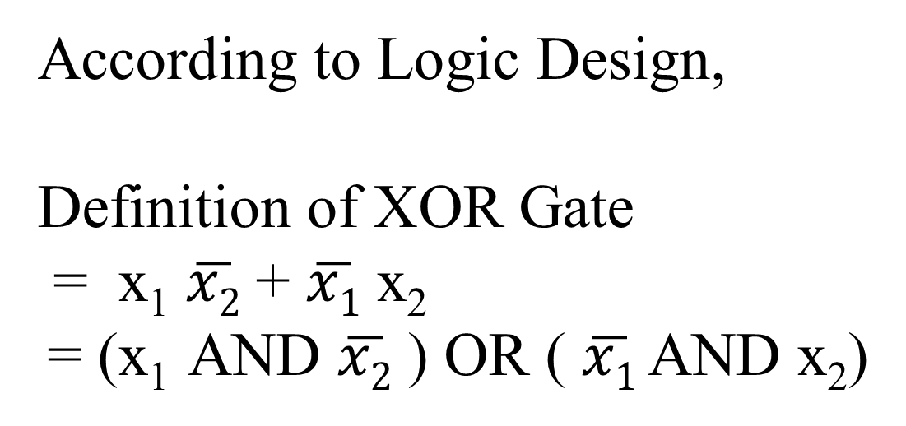
XOR Gate Realization
XOR Truth Table
According to Logic Design,
Definition of XOR Gate
= x₁ $\overline{x2}$ + $\overline{x1}$ x₂
= (x₁ AND $\overline{x2}$ ) OR ( $\overline{x1}$ AND x₂)
x1 | x2 | Output
0 | 0 | 0
0 | 1 | 1
1 | 0 | 1
1 | 1 | 0
By comparing the equation
and network diagram
= x₁ $\overline{x2}$ + $\overline{x1}$ x₂
x₁
w11
Z₁
w12
wz1
Y_{out}
w21
wz2
x₂
w22
Z₂
Z1
Z2

Slide 3
x₁
w11
Z₁
When we have additional layers in the network, the output of the intermediate layers will be computed first, and the result will be passed onto the next layer.
Every neuron from one layer to another layer is INTERCONNECTED by using weights.
w12
wz1
Y_{out}
w21
wz2
x₂
w22
Z₂
Input Layer
Output Layer
Layer 1
Revised Definitions of the network nodes
Z₁= x₁ * w₁₁ + x₂ * w₂₁
X1 and x2 remains as it is.
Y_{out} = Z₁ * w_{Z1} + Z₂ * w_{Z2}
Z₂= x₁ * w₂₁ + x₂ * w₂₂

Slide 4
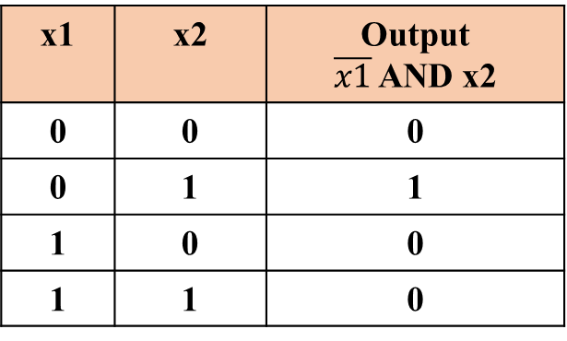
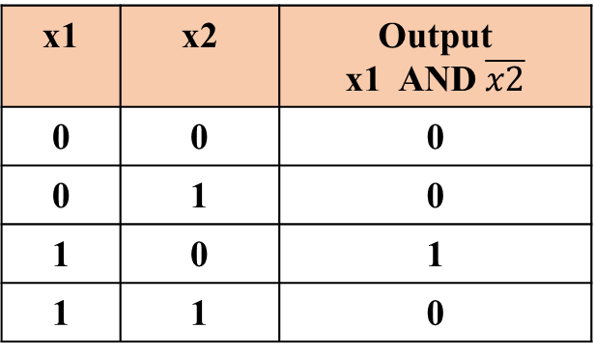
Before proceeding for next layer computations verify it Z1 and Z2 Output is correct.
Generate the truth table for Z1 and Z2 using Logic Design
Z1
Z2
x1 | x2 | Output x1 AND $\overline{x2}$
0 | 0 | 0
0 | 1 | 0
1 | 0 | 1
1 | 1 | 0
x1 | x2 | Output $\overline{x1}$ AND x2
0 | 0 | 0
0 | 1 | 1
1 | 0 | 0
1 | 1 | 0

Slide 5

CASE - I
Assuming w₁₁= w₂₁= 1
Layer 1 Computations
Z₁= x₁ * w₁₁ + x₂ * w₂₁
X₁ | X₂ | Z₁
0 | 0 | = (0 * 1) + ( 0 * 1) = 0
0 | 1 | = (0 * 1) + ( 1 * 1) = 1
1 | 0 | = (1 * 1) + ( 0 * 1) = 1
1 | 1 | = (1 * 1) + ( 1 * 1) = 2
√
x1 | x2 | Output x1 AND $\overline{x2}$
0 | 0 | 0
0 | 1 | 0
1 | 0 | 1
1 | 1 | 0
X
√
X
But no Threshold Value can be decided…
Hence weights need to be adjusted.

Slide 6
CASE - II
Assuming w₁₁= 1 w₂₁= -1
Layer 1 Computations
Z₁= x₁ * w₁₁ + x₂ * w₂₁
X₁ | X₂ | Z₁
0 | 0 | = (0 * 1) + ( 0 * -1) = 0
0 | 1 | = (0 * 1) + ( 1 * -1) = -1
1 | 0 | = (1 * 1) + ( 0 * -1) = 1
1 | 1 | = (1 * 1) + ( 1 * -1) = 0
√
x1 | x2 | Output x1 AND $\overline{x2}$
0 | 0 | 0
0 | 1 | 0
1 | 0 | 1
1 | 1 | 0
√
√
√
= 1 if Z₁ >= 1
= 0 if Z₁ < 1

Slide 7

CASE - II
Assuming w₁₂= -1 w₂₂= 1
Z₂= x₁ * w₂₁ + x₂ * w₂₂
Layer 1 Computations
X₁ | X₂ | Z₂
0 | 0 | = (0 * -1) + ( 0 * 1) = 0
0 | 1 | = (0 * -1) + ( 1 * 1) = 1
1 | 0 | = (1 * -1) + ( 0 * 1) = -1
1 | 1 | = (1 * -1) + ( 1 * 1) = 0
x1 | x2 | Output $\overline{x1}$ AND x2
0 | 0 | 0
0 | 1 | 1
1 | 0 | 0
1 | 1 | 0
√
√
√
√
= 1 if Z₁ >= 1
= 0 if Z₁ < 1

Slide 8
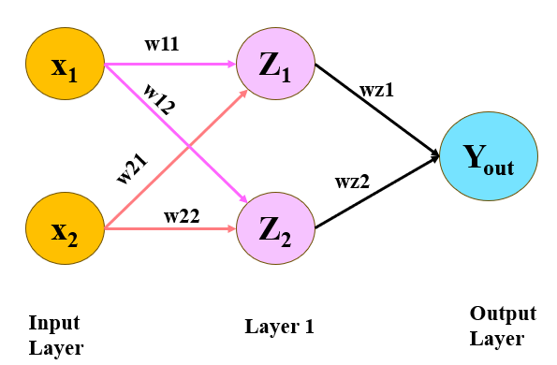
CASE - I
Assuming w_{z1}= w_{z2}= 1
Layer 2 Computations
Y_{out} = Z₁ * w_{Z1} + Z₂ * w_{Z2}
Z₁ | Z₂ | Y_{OUT}
0 | 0 | = (0 * 1) + ( 0 * 1) = 0
0 | 1 | = (0 * 1) + ( 1 * 1) = 1
1 | 0 | = (1 * 1) + ( 0 * 1) = 1
0 | 0 | = (0 * 1) + ( 0 * 1) = 0
x1 | x2 | Output
0 | 0 | 0
0 | 1 | 1
1 | 0 | 1
1 | 1 | 0

Slide 9
Neuron Modelling for ANN
Unit - 1

Slide 10
General symbol for a neuron

Slide 11
What is an Activation Function?
An activation function is a mathematical expression that calculates the output of a node in an artificial neural network based on its inputs and their weights.
Also known as “Transfer Function”, “Squashing function”.
It limits the amplitude range of neuron’s output to a finite value.

Slide 12
Why do we use Activation Function?
Introduction of non-linearity.
Mitigation vanishing or exploding gradients.
Enabling decision boundaries.

Slide 13
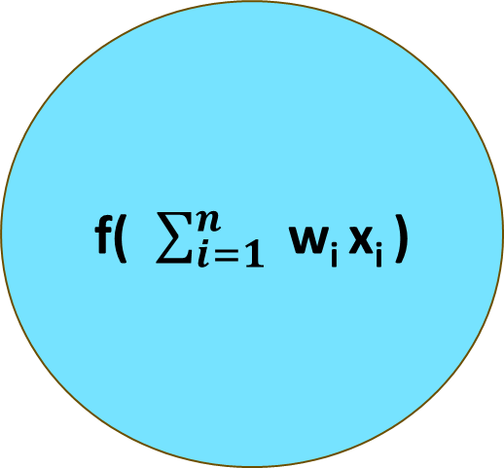
x₁
f = Activation Function
w1
f( $\sum_{i=1}^{n}{ }$w_{i} x_{i} )
x₂
Y_{out}
w2
wn
x_{n}
Net input
f(W^{T} X)

Slide 14
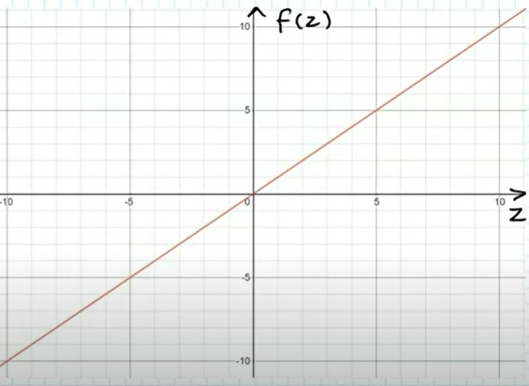
Linear Activation Function
(Identification Function)
Definition
f(x) = x for all x
Used when output should be same as input signal.
It is a “constant gradient”.
Applied for “Regression”.
It does not squash or transform the output.
Range = (-∞, +∞)

Slide 15
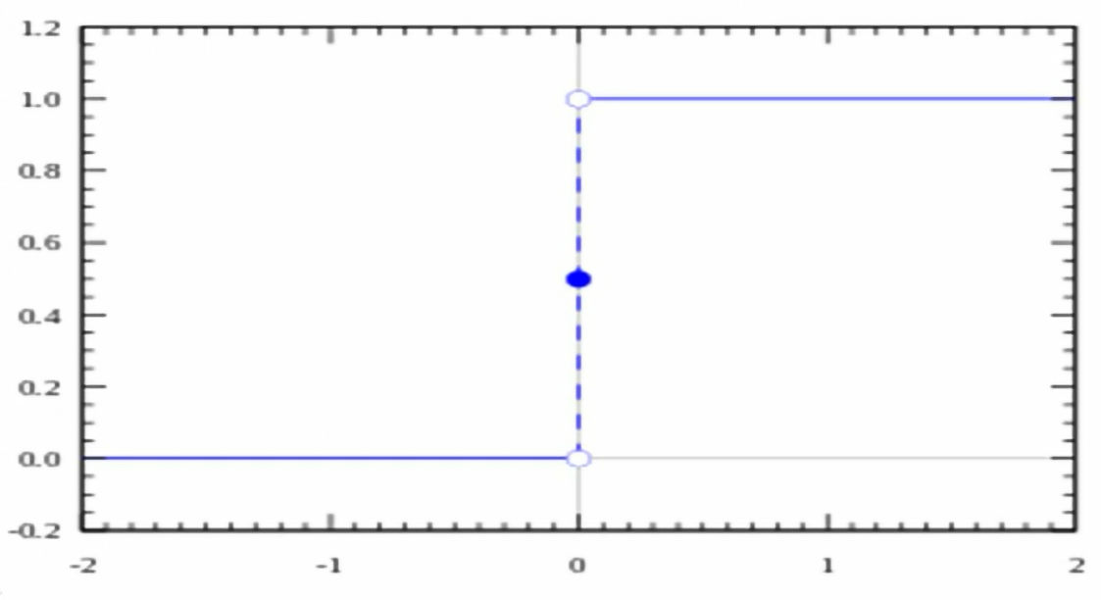
Binary Step Function
Defined as:
f(x) = 1 ≥ Ɵ
= 0 < Ɵ
Step function is a “threshold based” activation function.
Applied for “Classification”.
Range = (0,1)

Slide 16
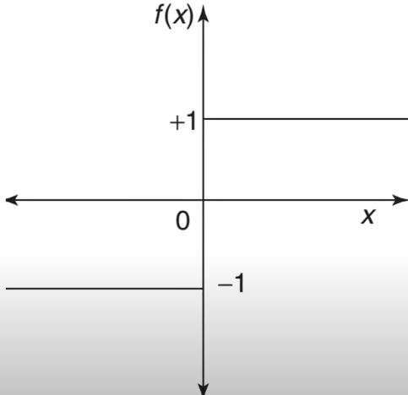
Bipolar Step Function
Defined as:
f(x) = 1 ≥ Ɵ
= -1 < Ɵ
Step function is a “threshold based” activation function.
Applied for “Classification”.
Range = (-1 , 1)

Slide 17
Signum Step Function
Defined as:
f(x) = 1 > 0
= 0 = 0
= -1 < 0
Step function is a “threshold based” activation function.
Applied for “Classification”.
Range = (-1 , 1)

Slide 18
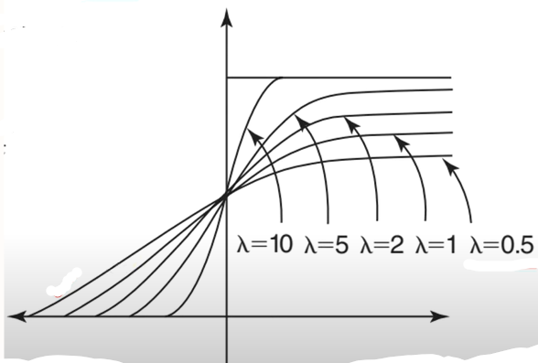
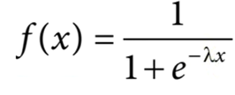
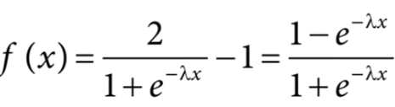
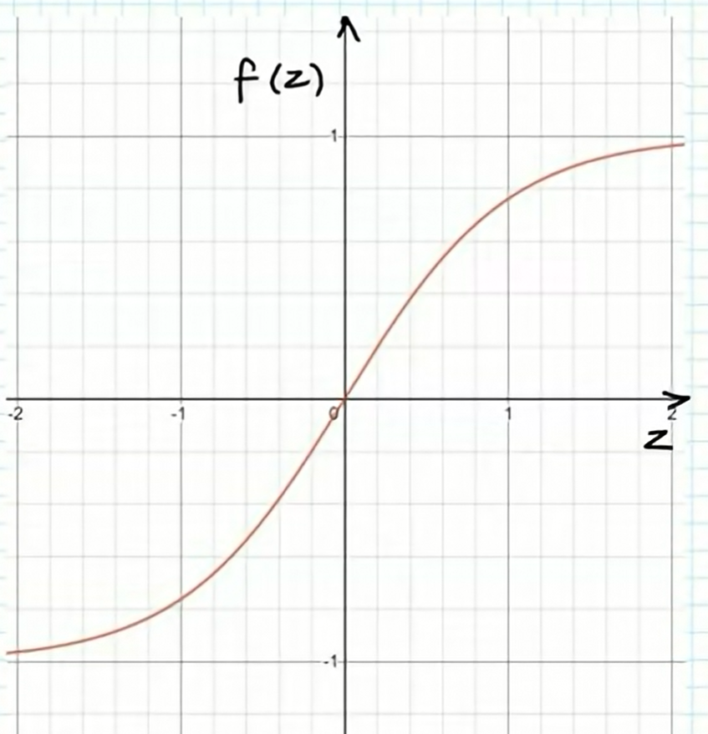
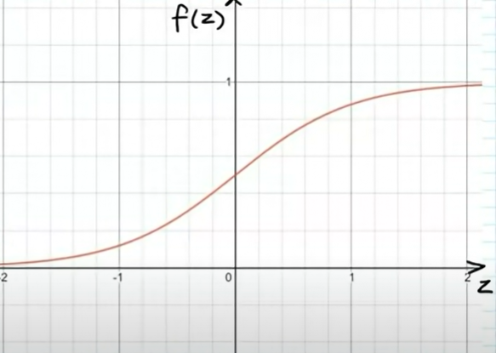
Sigmoid Function
Logistic / Unipolar
Binary Sigmoid Function
Bipolar Sigmoid Function
Range = (-1 to 1)
Range = (0 to 1)

Slide 19


Derivative of the Sigmoid Functions
Binary Sigmoid Function
Bipolar Sigmoid Function

Slide 20
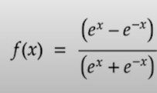
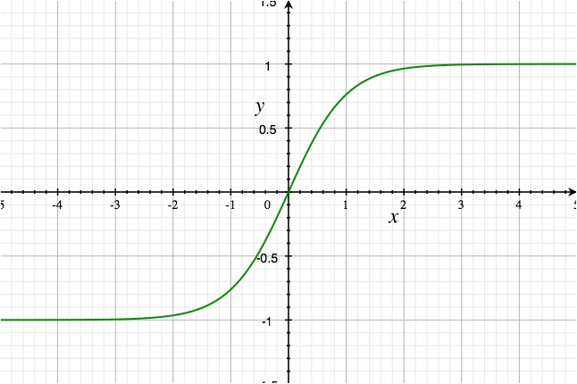
Hyperbolic Tangent(Tanh) Function
Definition:
It can deal with negative values more effectively than the sigmoid function.
Tanh is zero-centered, which means that its output is symmetric around the origin of the coordinate system.
The sigmoid function has a slower rate of change than the tanh function, which means that the derivative of the sigmoid function will be smaller than the derivative of the tanh function for a given input

Slide 21
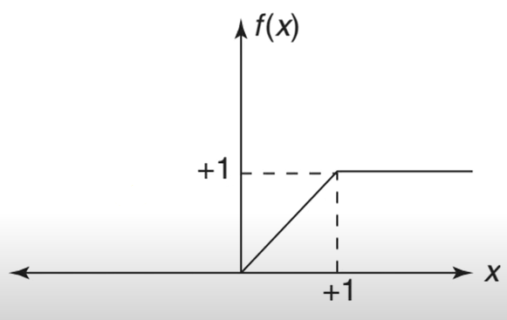
Ramp Function
Defined as:
f(x) = 1 x>1
= x 0 ≤ x ≤1
= 0 x<0
However the ramp will have a steep curve
rather than a smooth one.
A linear function that has been shortened.

Slide 22

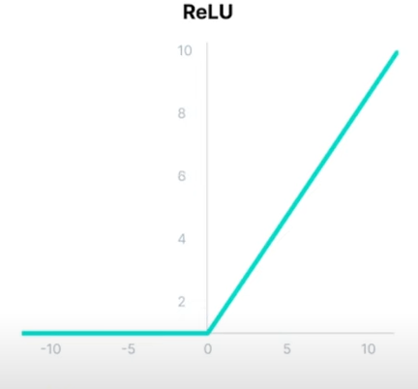
ReLU Function
Rectified Linear Unit
It seems as a Linear function in nature, but ReLU has a derivative function and allows backpropagation while simultaneously making it computationally efficient.
The main point – ReLU function does not activate all the neurons at the same time.
Range = ( 0 to ∞)

Slide 23
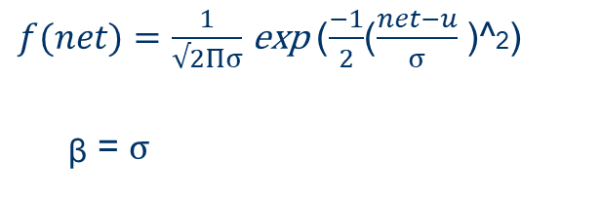
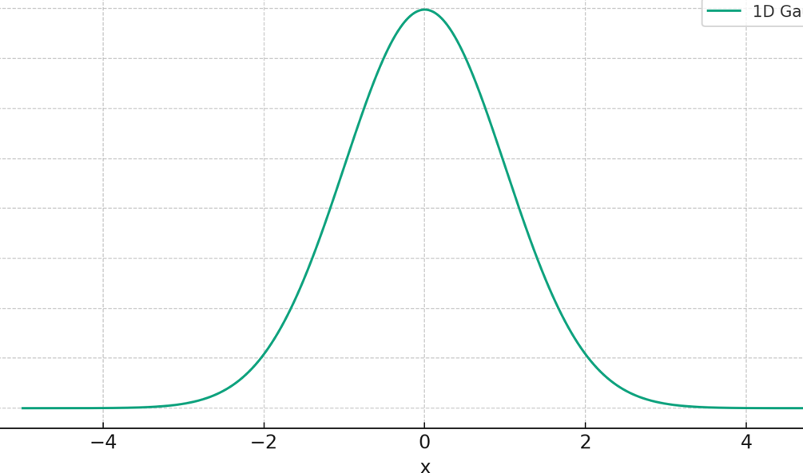
Gaussian Activation Function
Characterized by its bell-shaped graph, where most data points are near the middle (average), and the likelihood of getting values decreases as you move away from the average.
This curve is symmetric.

Slide 24
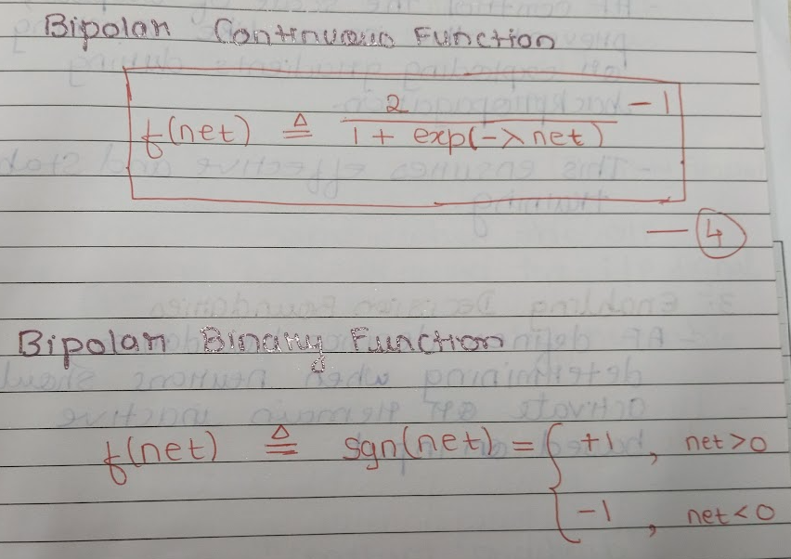

Slide 25
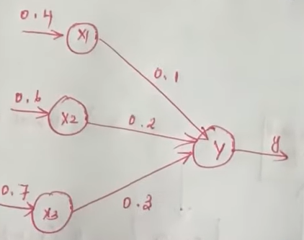
Net input = 0.37 f(x) = f(0.37) = ?
f(x) = x for all x | 0.37
Binary Step Function | 1
Threshold = 0.5 and Lambda =1
Unipolar Sigmoid | 0.5914

Slide 26
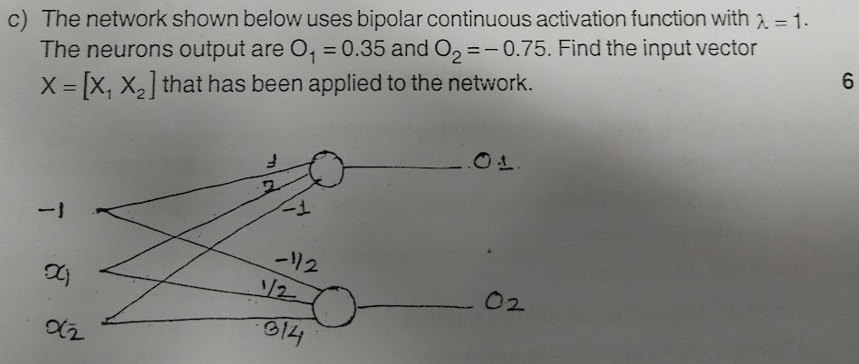
Unit – 1 : Assignment Q2

Slide 27
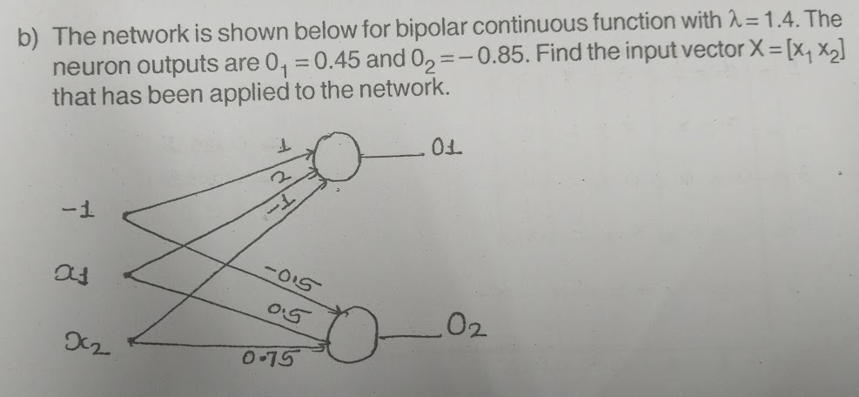

Slide 28
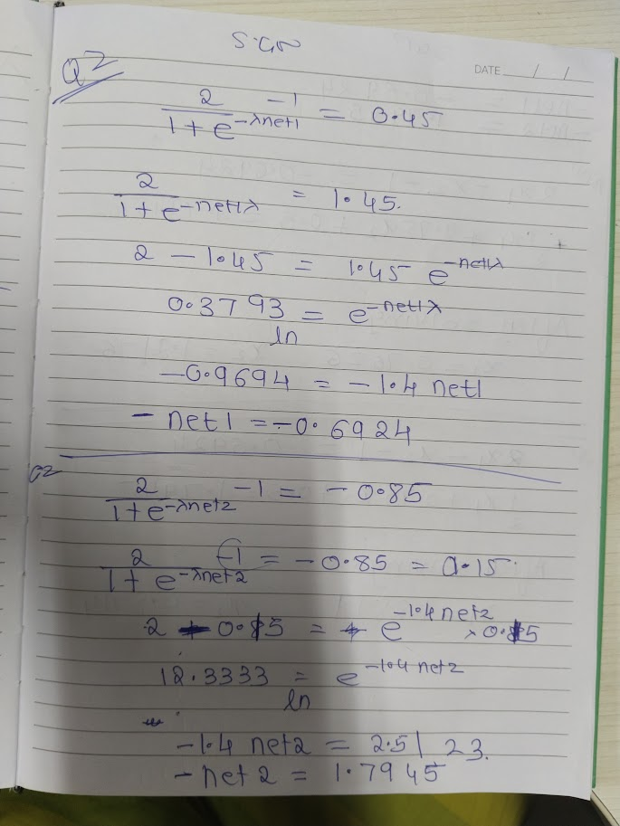
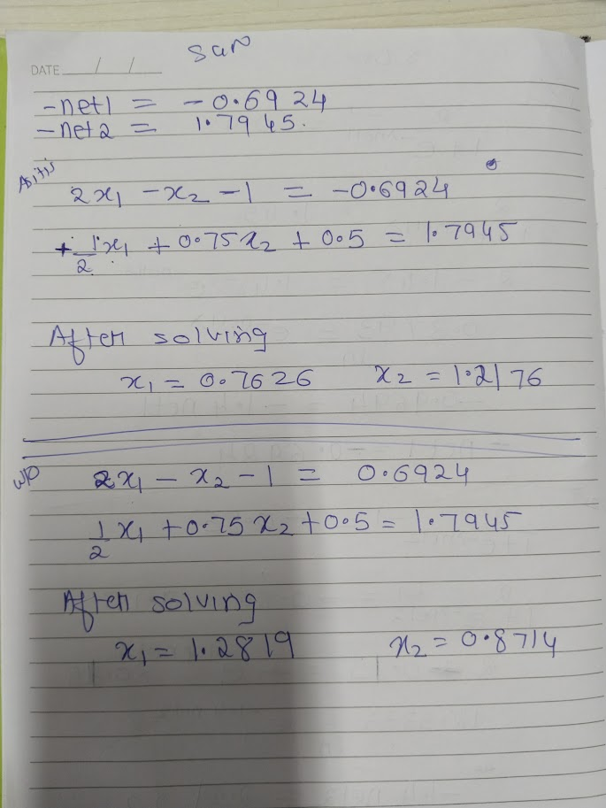

Slide 29
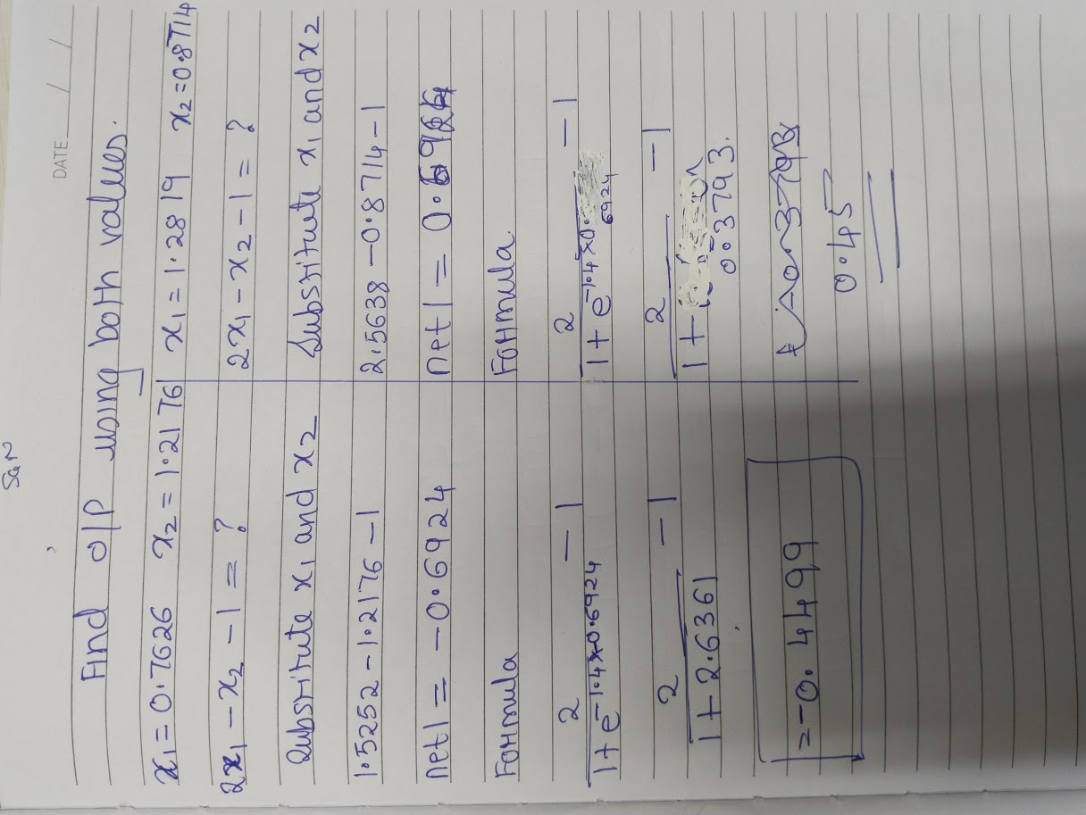

Slide 30
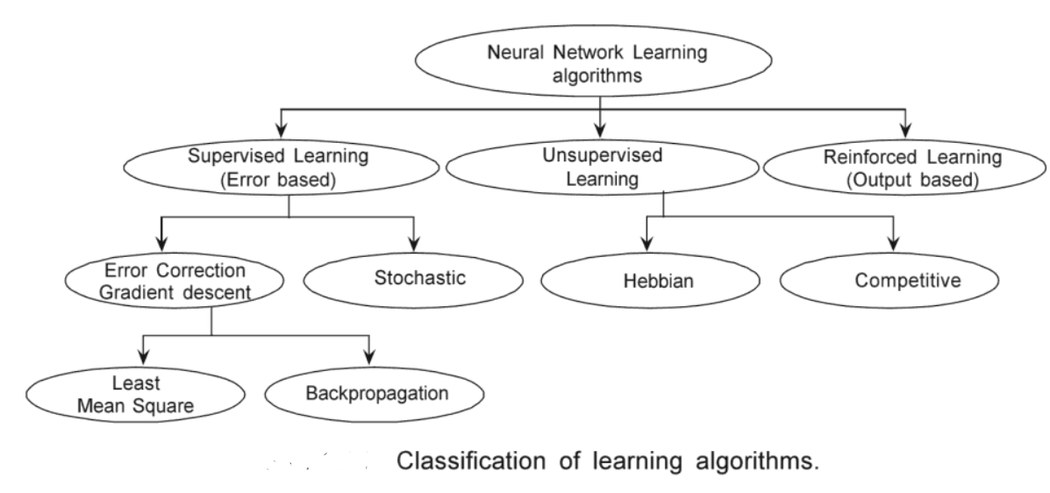
Neural Learning

Slide 31
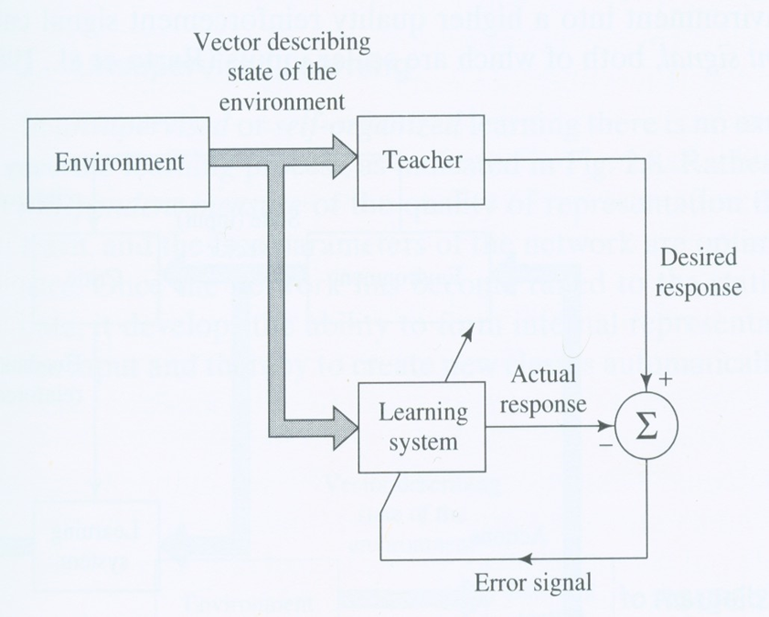
Supervised Learning
Given: Input samples and desired outputs.
The input samples are presented to network and actual output is calculated.
The error between actual and desired output is calculated.
This error is used for weight updating iteratively in step by step manner.
Training stops when error for all pattern becomes 0 over the iterations (When actual and expected outputs match for all patterns over number of iterations).
Applications: pattern classify-cation, function approximation

Slide 32

Unsupervised Learning
Given: Input patterns
It is carried out in absence of teacher.
Desired response is unknown. No information is available to correct the response.
The network modifies the weights depending on observations of the responses of the output.
The weights are adjusted in such a way that most similar input patterns are assigned to same output unit.
The training is complete when the patterns starts getting classified to same class over number of iterations.

Slide 33
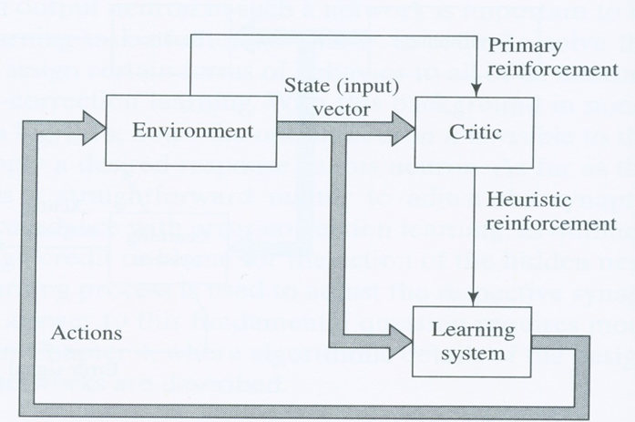
Reinforcement Learning
Reinforcement learning (RL) is a type of machine learning where an agent learns to make decisions by performing actions in an environment to maximize a reward.
Agent – Environment – State - Action – Reward – Policy – Value Function - QLearning
Workflow of RL
  Initialization → Interaction → Learning → Exploration vs. Exploitation →Convergence

